Slide 1
Economic Outlook on India
Alissa Klinetob

Slide 2
India’s Economy in Comparison to the United States
India
Exports: $301.90 billion
Imports: $503.50 billion
GDP: $1.84 trillion
Gross National Income: $477.00 billion
Unemployment Rate: 8.5%
Inflation Rate: 9.7%
United States
Exports: $1.56 trillion
Imports: $2.30 trillion
GDP: $15.68 trillion
Gross National Income: $9.78 trillion
Unemployment Rate: 8.1%
Inflation Rate: 2.1%
https://www.nationmaster.com/country-info/compare/India/United-States/Economy

Slide 3
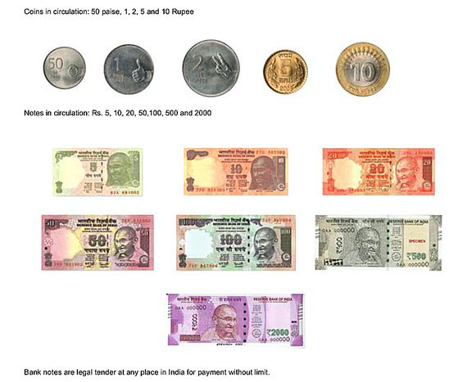
Currency in India
India uses the Rupee as their form of currency
One Rupee is equivalent to 0.013 US dollars
Banknotes (paper money) are issued in increments of 5, 10, 20, 50, 100, 500, and 2,000 rupees.
Coins are issued in increments of 50 paise, 1 rupee, 2 rupees, 5 rupees, and 10 rupees. (1 paise is equivalent to 1/100 of a rupee)
History:
The Indian Rupee originated from the ‘rupiya’ which was a silver coin that was named after Sultan Sher Shah Suri in the 16th century.
inr.asp

Slide 4
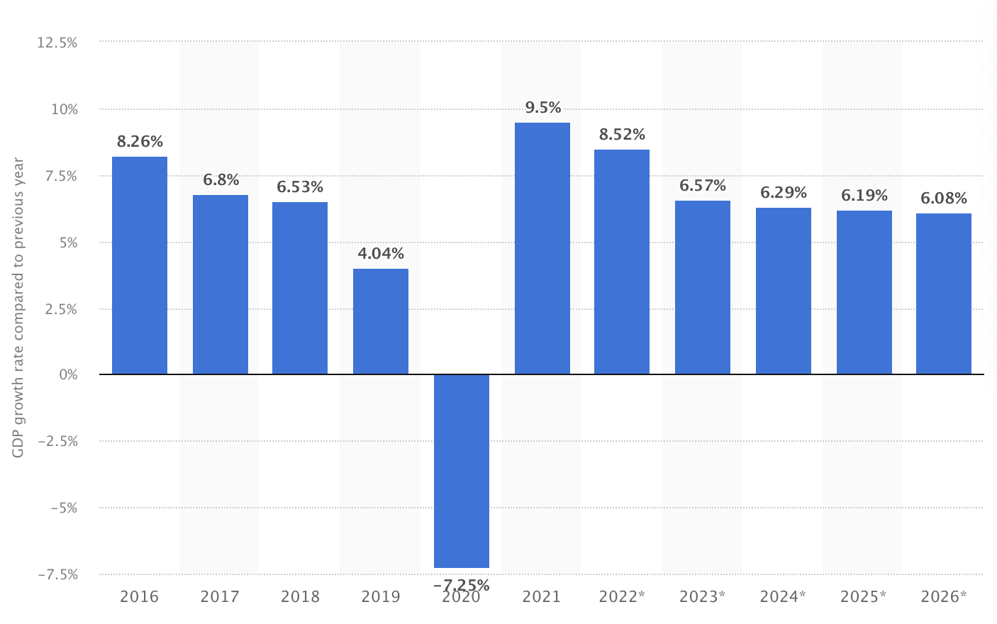
Real GDP Growth Rate
In 2020, the Real GDP growth rate was -7.25% in comparison to the previous year (2019)
This is likely a result of the COVID-19 pandemic (unemployment, staying home, etc.)
It is predicted to have a steady increase in the Real GDP in the upcoming years
The GDP growth has slowed down in the recent years partly as a result of India’s rapidly growing inflation.
gross-domestic-product-gdp-growth-rate-in-india

Slide 5
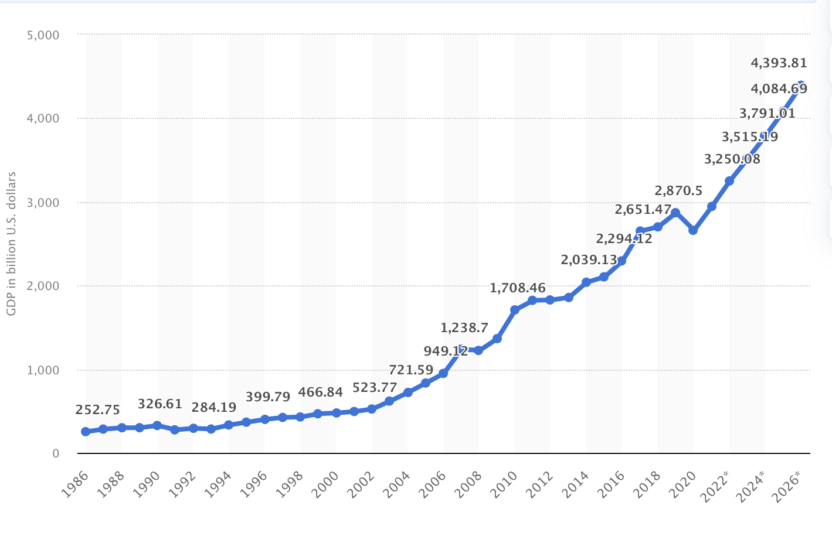
GDP in India
Mixed economy (capitalist and socialist )
Their efforts to move toward a Soviet-style mass planning system because of a wide variety of hindrances such as an unskilled workforce.
The GDP is steadily increasing despite a slight drop in 2020 as a result of the COVID-19 pandemic
Many of India’s exports include agricultural products, jewelry, chemicals, and ores.
Although India doesn’t export large amount of items, they are still considered one the world’s largest exporters
India’s imports mostly include crude oil, gold, and precious stones which are primarily used in their jewelry making.
gross-domestic-product-gdp-in-india

Slide 6
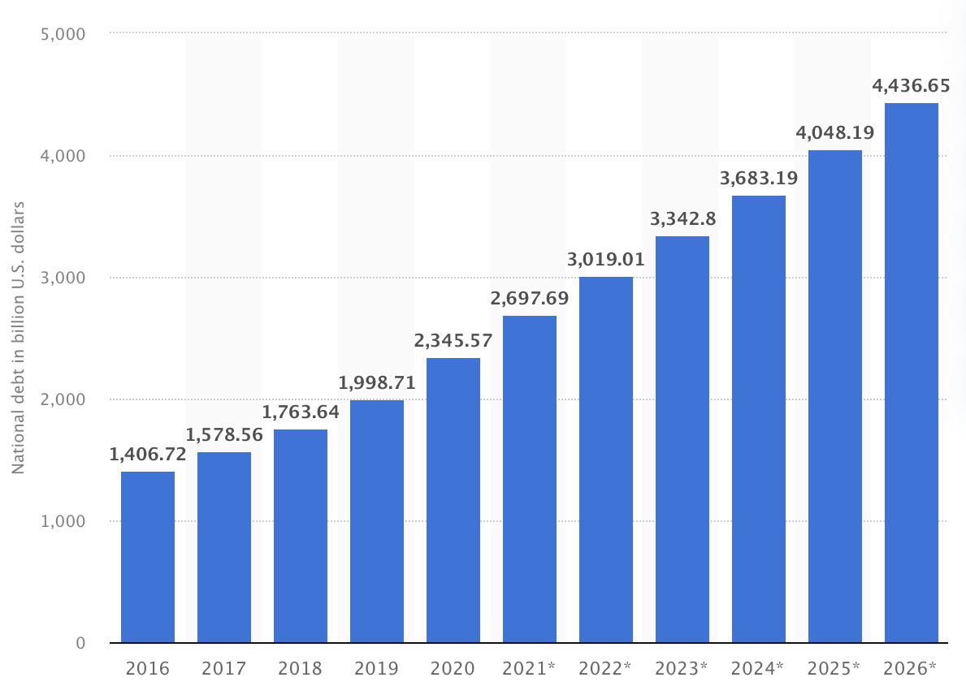
National Debt
India’s national debt is steadily increasing, and is predicted to continually increase at this steady rate until the year 2026.
India is borrowing and investing in many commercial banks and sever non-banking finance companies.
Today, nearly 70% of India’s GDP is made up of its national debt.
https://www.statista.com/statistics/531619/national-debt-of-india/

Slide 7
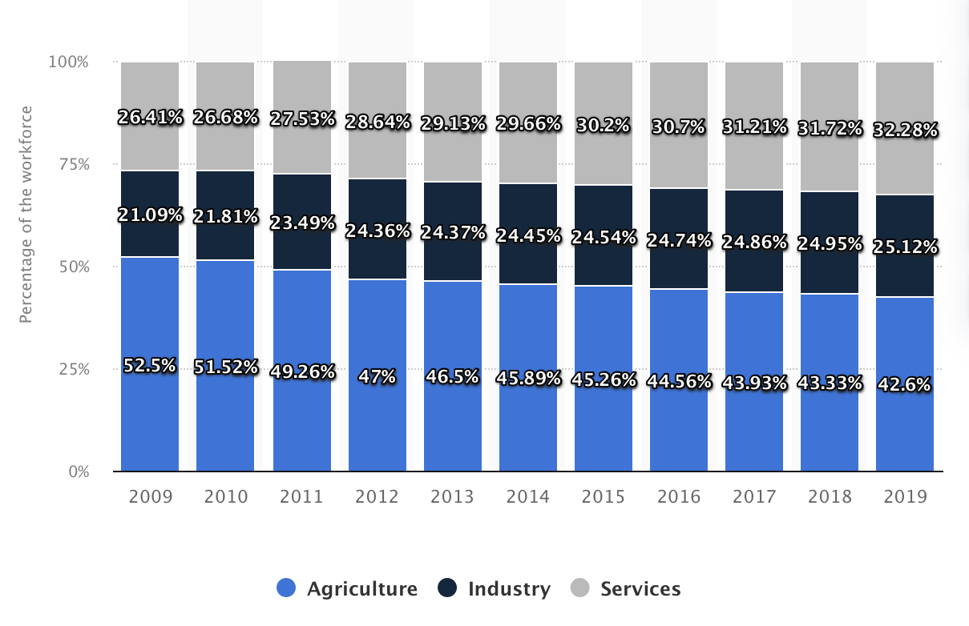
Employment Sectors
Nearly 50% of India’s workforce was employed in agriculture between the years of 2009 and 2019.
Although India’s agricultural workforce is slowly declining, it still hold the overwhelming majority of workers in comparison to industry and services.
The remainder of the workforce was relatively evenly distributed between industry and service jobs.
Individuals that are employed in services are gradually increasing; possibly beginning to take over the agricultural jobs.
distribution-of-the-workforce-across-economic-sectors-in-india

Slide 8
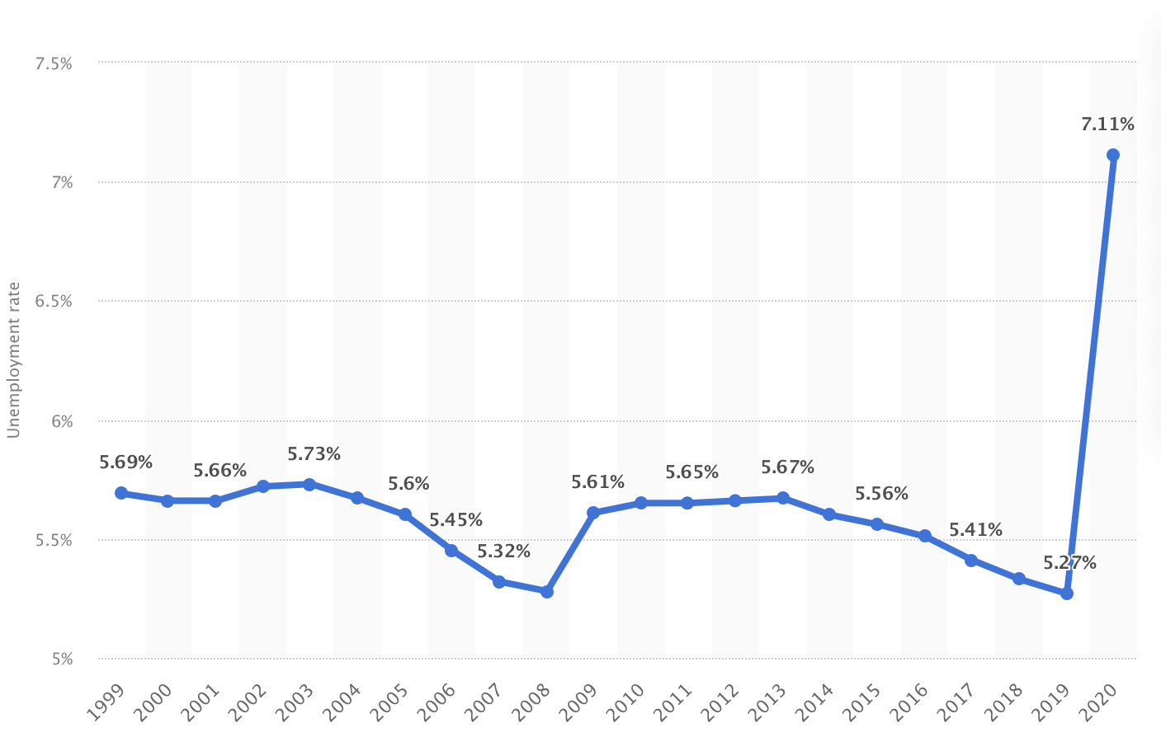
Unemployment Rate
The Unemployment rate in India was relatively steady from 1999 - 2019, but it skyrocketed in the year 2020 (7.11%) as a result of the COVID-19 pandemic.
Employers couldn’t afford to pay their employees so they were forced to let many of them go, resulting in an increase in the unemployment rate.
https://www.statista.com/statistics/271330/unemployment-rate-in-india/

Slide 9
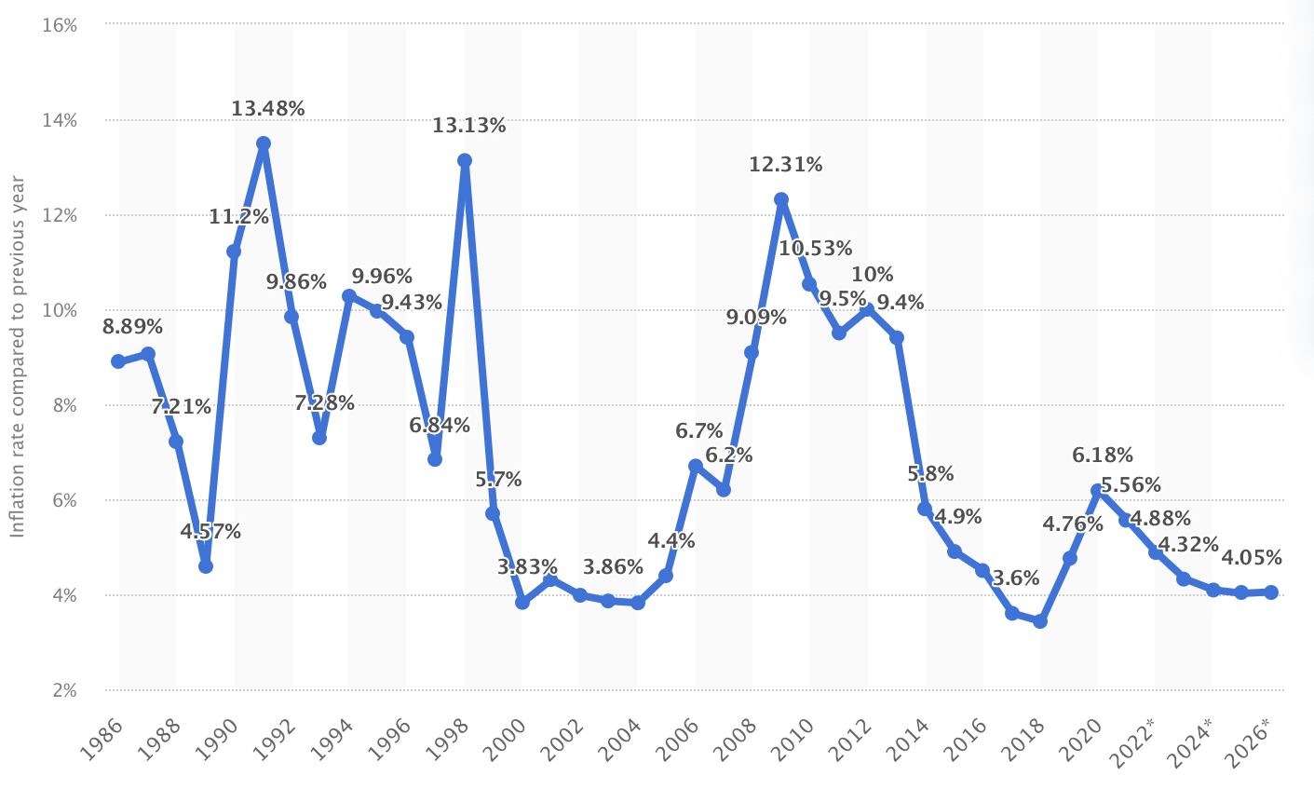
Inflation Rate
India’s inflation rate has fluctuated a lot over the years, and as of now, its extremely high
This is likely because of the rising food, fuel, and other prices.
India’s inflation rate in 2020 was seen to be 6.18% in comparison to 2019.
https://www.statista.com/statistics/271322/inflation-rate-in-india/

Slide 10
Reference Page
https://www.statista.com
https://www.nationmaster.com/country-info/compare/India/United-States/Economy
https://www.investopedia.com/terms/i/inr.asp

